Slide 1


Webathon
Power Point Presentation on
Online Learning
Under the guidance
Rahul Ahire Sir
&
Rushikesh Sir
Created By
Tejas Dilip Waghmare

Slide 2
Agenda
Introduction
Problem Statement
Objectives
Methodology
Results
Recommendations
Reference
Conclusion

Slide 3
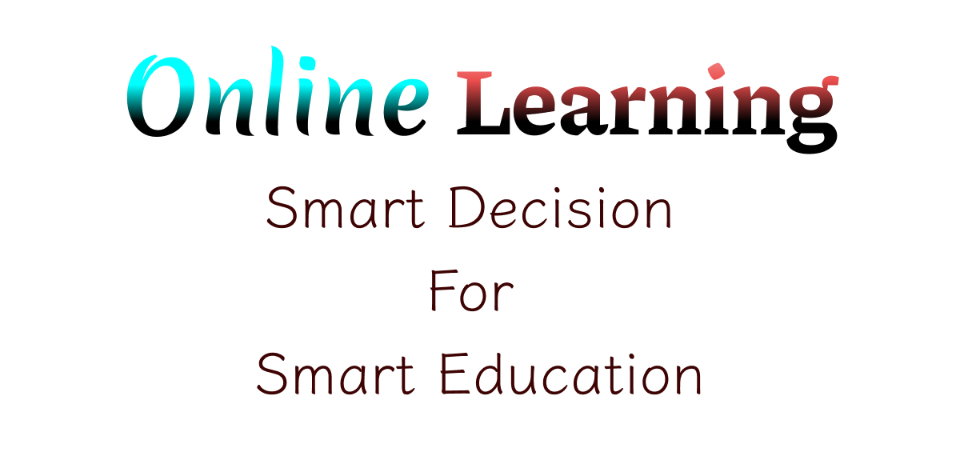

Introduction
Our free online learning provides for students a free and flexible way to learn the Balbharti syllabus as a textbook and more activities…

Slide 4
Problem Statement
There are so many students we see physically not attend school or those who have any problem to attend school then those student can get help from this website Online Learning.
So they will not miss there syllabus.

Slide 5
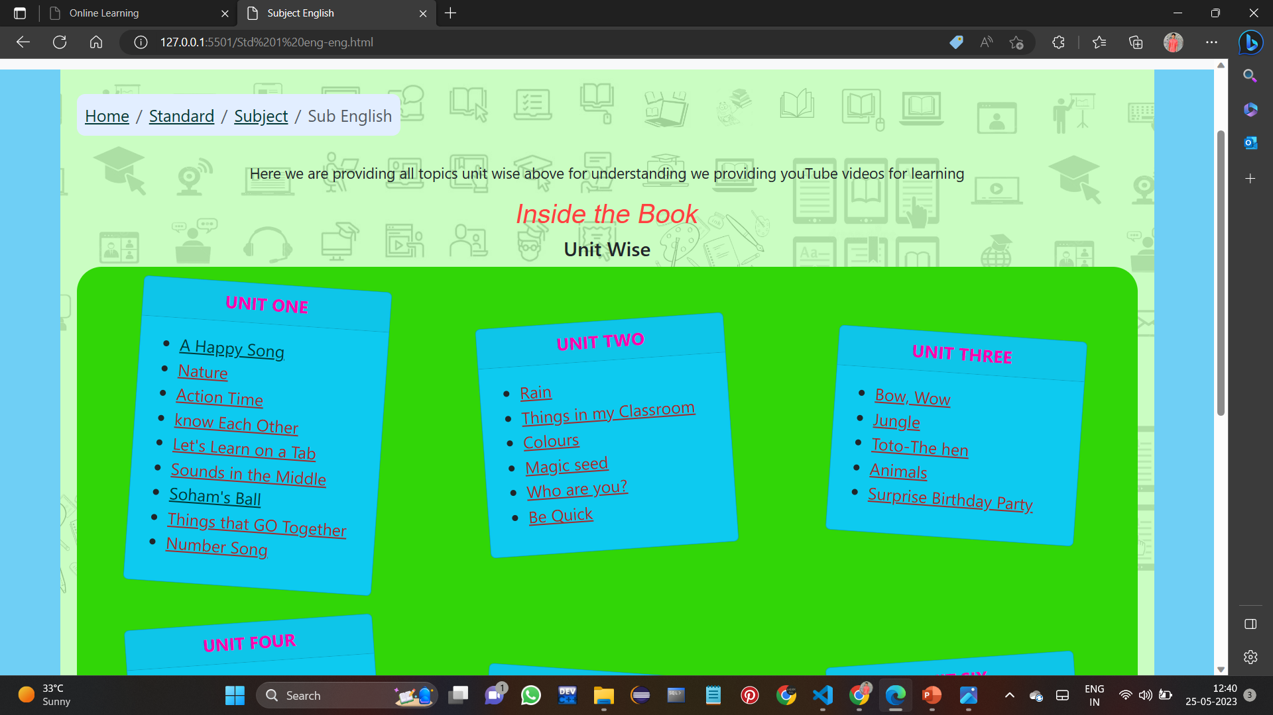
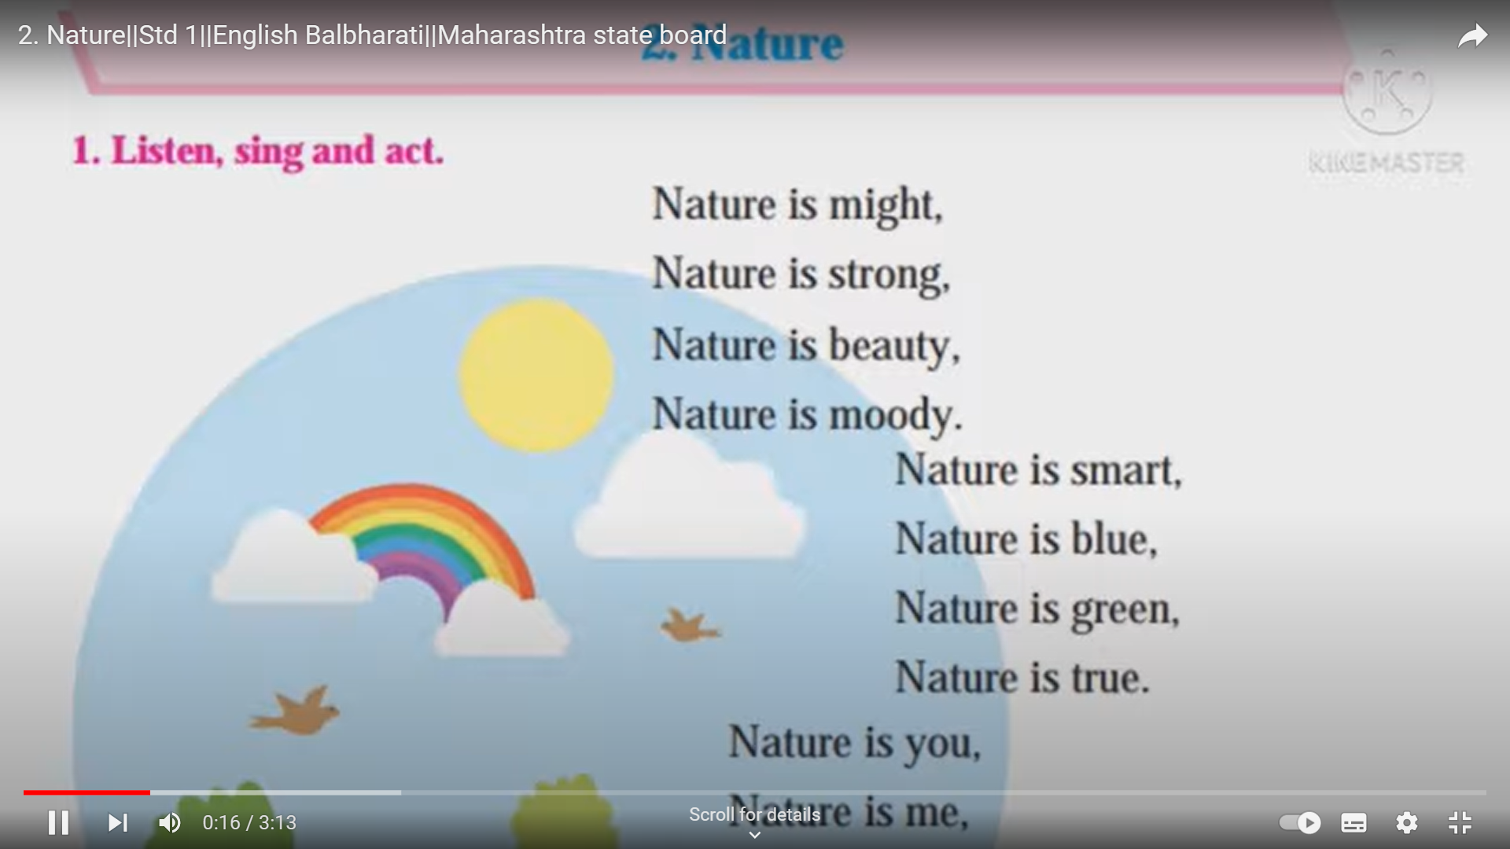
Objectives
Facilitate Learning:
Enabling them to access educational resources

Slide 6
Objectives
Deliver Engaging Content:
Develop and curate high-quality and interactive learning content, such as videos, textbooks, activities, and scholarships to enhance student engagement and knowledge retention.
Personalize Learning Experience:
Implement features that allow students to customize their learning path, track their progress, and receive personalized recommendations based on their interests, learning style, and performance.

Slide 7
Methodology
Data Collection:
In this platform we are enables the video lectures, textbooks in pdf format, so students don’t have to go anywhere and they can easily get data as they want.
Content Creation and Deployment :
We are created many pages standard wise and subject wise so students can got easily syllabus and videos.

Slide 8
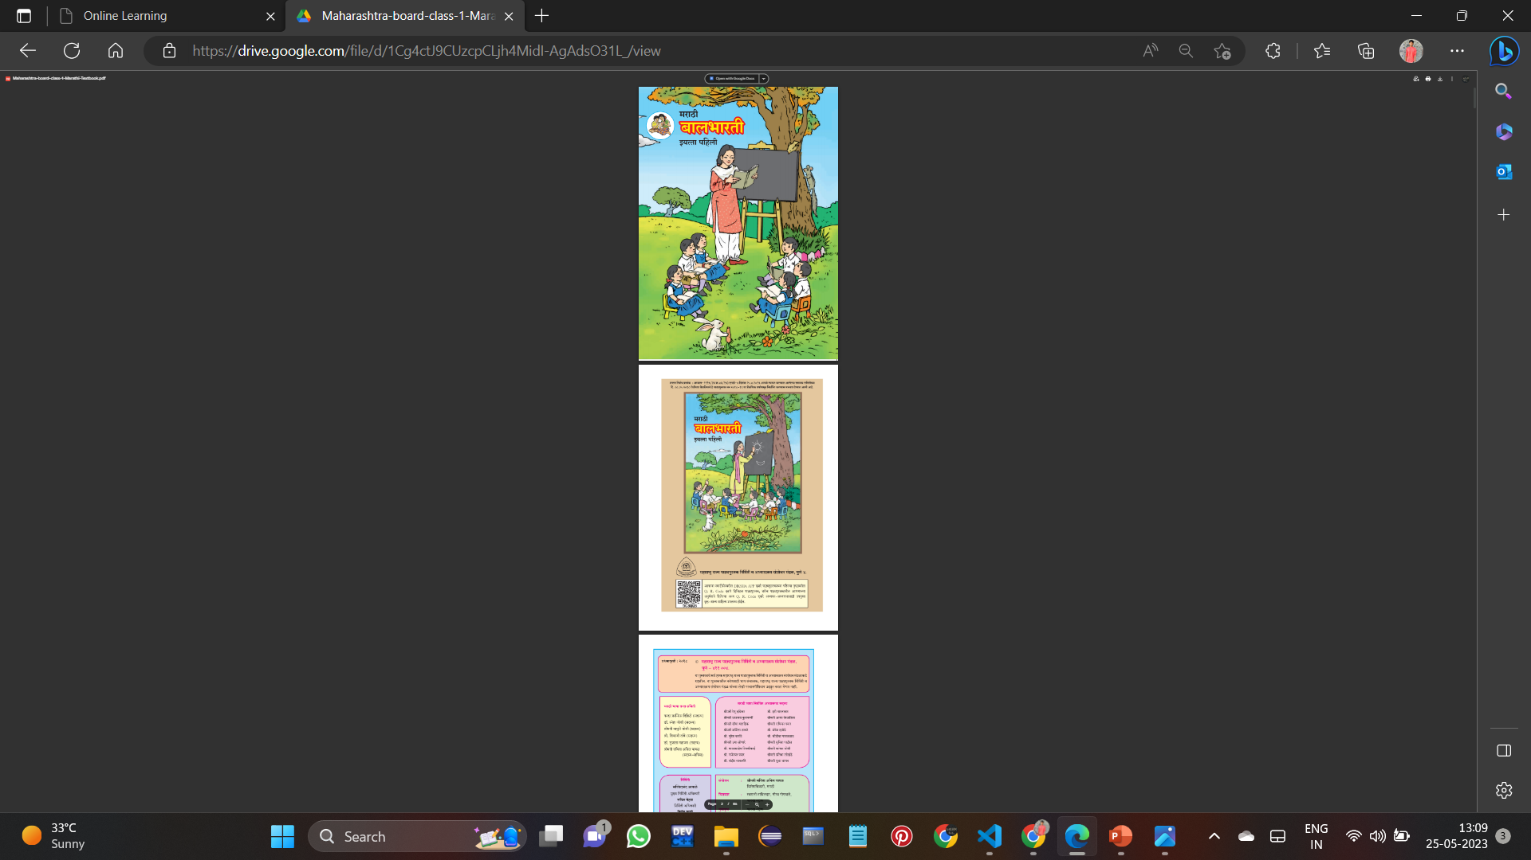
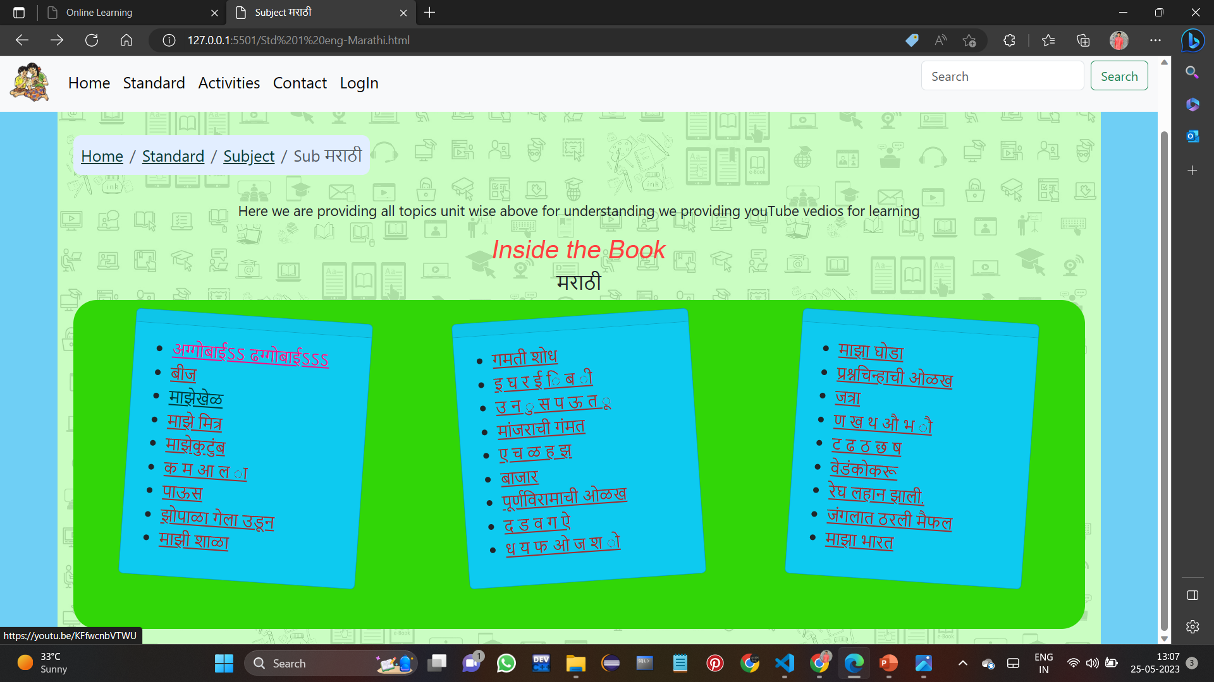
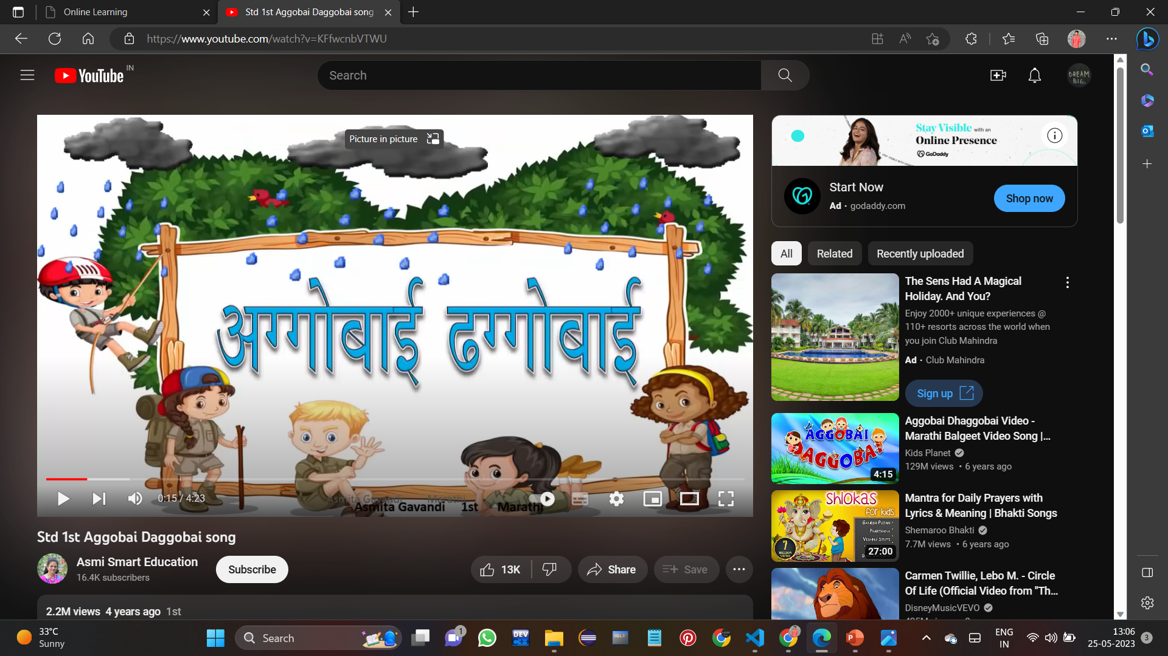
Results
Increased Learning Accessibility
Improve Learning Outcomes

Slide 9
Recommendation
Enhance the Online Learning experience by incorporating interactive multimedia elements, such as videos, activities, and interactive assessments. This makes the learning process more engaging, memorable, and effective.
Encourage learners to provide feedback on their learning experience and the usability of the Online Learning website.
Implement features that enable personalized learning experiences based on learners' preferences, interests, and progress.

Slide 10
Reference
W3 schools https://www.w3schools.com/
Bootstrap https://getbootstrap.com/
MSB https://www.mahahsscboard.in/
YouTube https://www.youtube.com/

Slide 11

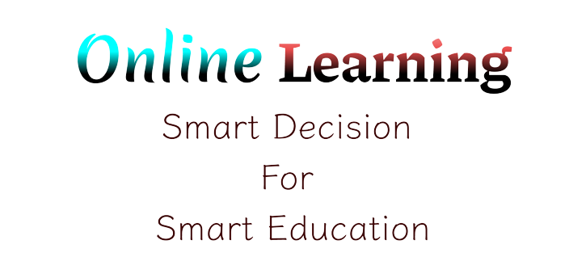
Conclusion
Developing an Online Learning website offers numerous benefits and opportunities for Students.
By creating a user-friendly platform that provides easy access to educational resources, interactive content, and personalized learning experiences, the Online Learning website can significantly enhance the learning process.

Slide 12
Thank You

